Slide 1
Concurrency
Threads & Synchronization

Slide 2
Agenda
Introduction
Exploring Threads
Sharing Resources
Inter-Thread Communication
Deadlock
Advanced Issues
Assignment

Slide 3
Introduction
Definition
Motivation
Process
Thread Memory Model
Threads compared with Processes

Slide 4
Definition
Objects provide a way to divide a program into independent sections. Often, you also need to turn a program into separate, independently running subtasks.
Each of these independent subtasks is called a thread.
A piece of code that run in concurrent with other threads.
Thread is a statically ordered sequence of instructions.

Slide 5
Process
A process is a self-contained running program with its own address space.
A multitasking operating system is capable of running more than one process (program) at a time.
A thread is a single sequential flow of control within a process.
A single process can thus have multiple concurrently executing threads
So threads are lightweight processes.

Slide 6
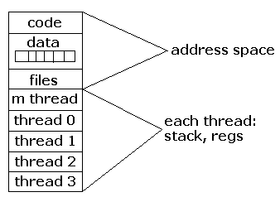
Process

Slide 7
Thread Memory Model
Memory that can be shared between threads is called shared memory or heap memory.
  All instance fields,
  static fields and
  array elements are stored in heap memory.
Local variables, method parameters and catched exception parameters are never shared between threads and stored in local stack and registers.

Slide 8
Threads compared with Processes
Processes are typically independent, while threads exist as subsets of a process
Processes carry considerable state information, whereas multiple threads within a process share state as well as memory and other resources
Processes have separate address spaces, whereas threads share their address space
Processes interact only through system-provided inter-process communication mechanisms.
Context switching between threads in the same process is typically faster than context switching between processes.

Slide 9
Exploring Threads
Thread Life Cycle
Thread Creation
Priority
Joining
Yielding
Sleeping
Interrupting

Slide 10
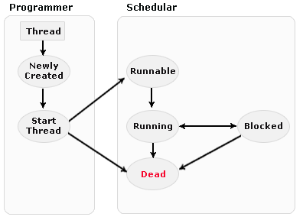
Thread Life Cycle
New state: The thread is considered not alive.
Runnable (Ready-to-run) state: A thread start its life. On this state a thread is waiting for a turn on the processor.
Running state: the thread is
currently executing
Dead state: its run() method completes.
Blocked: is waiting the resources that are hold by another thread.

Slide 11
Thread Creation
Two ways:
Using the System.Threading.Thread Class
  Create a new Thread object, passing a ThreadStart or ParameterizedThreadStart delegate.
  The delegate points to the method that will execute on the new thread.
Implementing the System.Threading.Tasks.Task Class
  A higher-level abstraction for representing an asynchronous operation.
  Managed by the ThreadPool, leading to more efficient resource usage.
Which to Choose?
Prefer Task for new development.
  It's the modern, preferred way to handle parallel and asynchronous work.
  Provides better performance through the ThreadPool.
Use the Thread class when you need:
  Explicit, long-running control over a foreground thread (a thread that keeps the application alive).

Slide 12
Priority
Thread Priority in C#
A thread's priority hints to the operating system scheduler how important it is relative to other threads.
  The scheduler uses these priorities to help determine the order and frequency of thread execution.
Priority Values
Priorities are set using the System.Threading.ThreadPriority enumeration.
  ThreadPriority.Lowest - Lowest priority
  ThreadPriority.BelowNormal
  ThreadPriority.Normal - The default priority
  ThreadPriority.AboveNormal
  ThreadPriority.Highest - Highest priority

Slide 13
Joining
Waiting for Threads with Join()
One thread can call Join() on another Thread object to wait for that thread to complete its execution.
The calling thread will block (pause) until the target thread terminates.
This is essential for coordinating work and ensuring one task finishes before another begins.

Slide 14
Sleeping
Causes the currently executing thread to pause for a given number of milliseconds.
When you call sleep( ), it must be placed inside a try block because it’s possible for sleep( ) to be interrupted before it times out.
It just stops the execution of the thread for a while.
There is no guaranty that thread will resume the execution after the given number of milliseconds.
Not to use in real-time application.

Slide 15
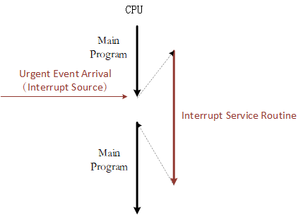
Interrupting
Interruption is a mechanism where a thread that is blocked (waiting, sleeping, etc.) can be forced to stop waiting and resume execution.
How It Works
  Thread.Interrupt() - Called by one thread on another thread object to interrupt its blocked state.
  ThreadInterruptedException - Thrown in the target thread when it is interrupted while in a waiting state.
  The interrupted thread
  must be in a blocked
  state (e.g., Sleep(), Join(),
  Wait()) for the interruption
  to take immediate effect.

Slide 16
Sharing Resources
Improperly accessing resources
Colliding over resources
Resolving shared resource conflict
  Semaphore
  Mutex (Mutual Exclusion)
  Synchronization
  Atomic Operations
  Volatile Variable
Critical sections

Slide 17
Colliding over resources
If one thread tries to read the data and other thread tries to update the same data, it leads to inconsistent state.
A race condition occurs when the order of execution of two or more threads may affect some variable or outcome in the program.
Race conditions can be considered harmless provided end result is correct. Otherwise needs to be handled.

Slide 18
Resolving shared resource conflict
Solution: Serialize access to shared resources
Semaphore: Semaphore is an object containing a value and two operations and used for communication between threads.
C# has built-in support to prevent collisions over resources in the form of the synchronized keyword.
It works much like the Semaphore.

Slide 19
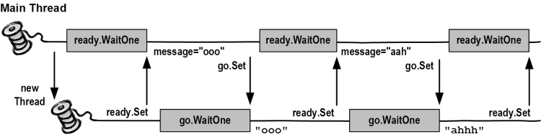
Resolving shared resource conflict…
Mutex: A mechanism in which a piece of code is running at a time by means of a lock (also called Monitor or Lock).
Locks in Java are reentrant. Reentrancy means that locks are acquired on a per-thread basis rather than per-invocation basis.

Slide 20
Synchronization (Cont…)
Only methods (or blocks) can be synchronized, Classes and variable cannot be synchronized.
If two threads wants to execute a synchronized method in a class, and both threads are using the same instance of the class to invoke the method then only one thread can execute the method at a time.
If you need to synchronize one method in a class, synchronize all of them, but this is not necessary.
You can synchronize a block of code rather than a method.
Constructors cannot be synchronized. Code inside the constructors can be synchronized.
Rule zero of concurrent programming: never make any assumptions.

Slide 21
Critical Sections
Piece of code that must be executed by one thread at a time
Must have solution that guarantees:
  Mutual exclusion (correctness)
  Absence of deadlock/unnecessary delay (no hang up)
  Randomly entry (fairness)
This is also called a synchronized block.

Slide 22
Inter-Thread Communication
When multiple threads are running inside an application, most of them will need to communicate with each other in some form.
Threads can communicate each other using wait() and Pulse()/PulseAll() methods without any race condition.
Wait-and-notify must be used in conjunction with the synchronized lock to prevent a race condition.
Methods wait(), Pulse() and Pulsell() are part of the base class Object and not part of Thread, as is sleep(). Why???

Slide 23
Inter-Thread Communication (Cont…)
sleep() does not release the lock when it is called but method wait() does release the lock.
The only place you can call wait( ), Pulse( ) or PulseAll( ) is within a synchronized method.
Restaurant Example: The waitperson must wait for the chef to prepare a meal. When the chef has a meal ready, the chef notifies the waitperson, who then gets the meal and goes back to waiting.
The chef represents the producer, and the waitperson represents the consumer.

Slide 24
Questions
?

